Slide 1
MATLAB Tutorial for Signal Processing
2020/3/12
翁笠群

Slide 2
Outline
MATLAB Installation and Self-Study Materials
Basic Function and Operation
Signal Processing in MATLAB
Using MATLAB for Course and Homework

Slide 3
MATLAB Installation
請從國立清華大學 MATLAB TAH 全校授權安裝
http://learning.cc.nthu.edu.tw/var/file/319/1319/img/2902/NTHU_MATLAB_TAHtw.pdf
版本選擇: R2019b
安裝設定 (Product Selection 預設即可)
請確保下列幾項都有安裝
Control System Toolbox 10.7
DSP System Toolbox 9.9
Image Processing Toolbox 11.0
Signal Processing Toolbox 8.3
English version http://learning.cc.nthu.edu.tw/var/file/319/1319/img/2902/NTHU_MATLAB_TAHen.pdf

Slide 4
Self-Study Materials (~1.5hr)
MATLAB 快速入門
https://ww2.mathworks.cn/help/matlab/getting-started-with-matlab.html
桌面基礎知識
矩陣和數組
數組索引
工作區變數
調用函數
編成和腳本
幫助和文檔
索引
基本繪圖函數
控制流
腳本與函數
English version https://www.mathworks.com/help/matlab/getting-started-with-matlab.html

Slide 5
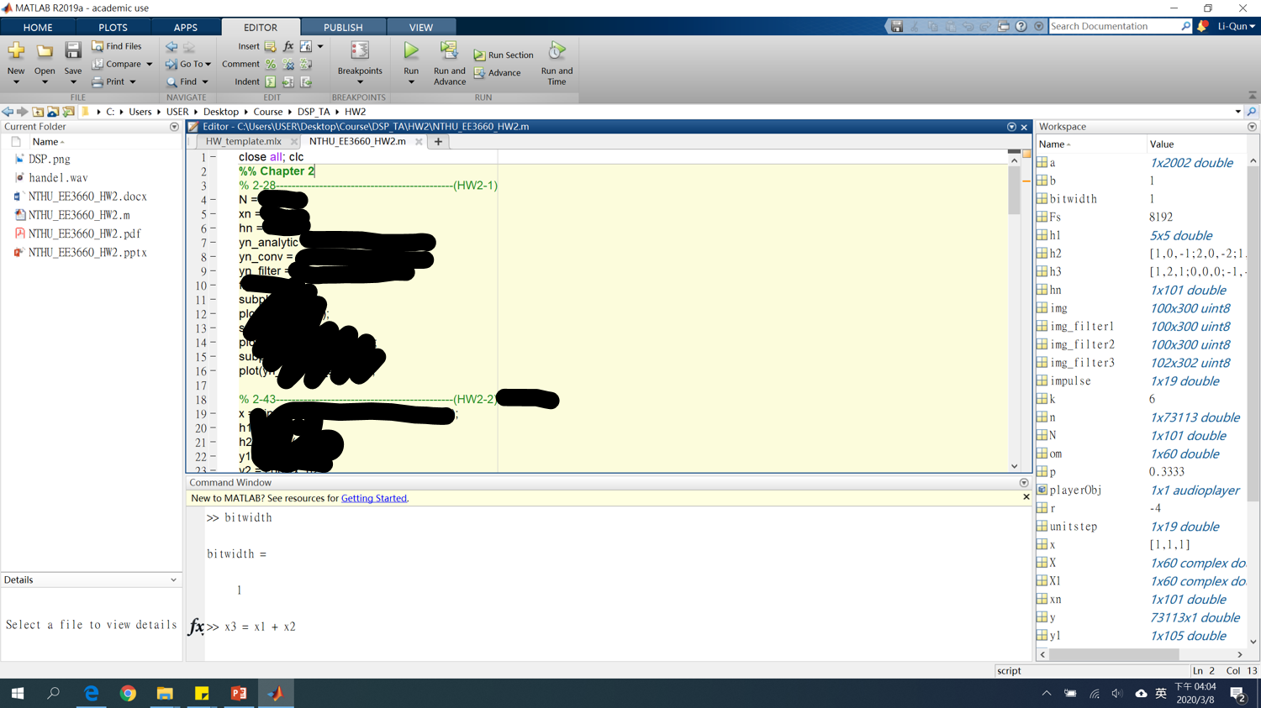
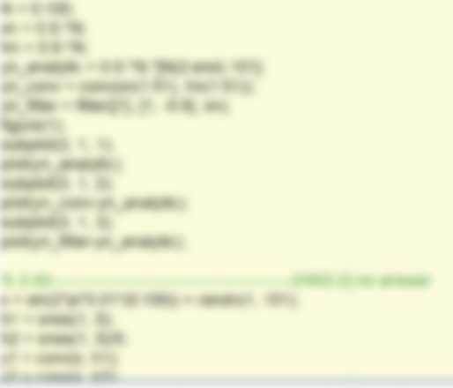
User Interface
Search Documentation
查詢toolbox, script , function使用方式
Editor
編輯code檔案(.m / .mlx)
(%: Commend, %%: Section
F5: Run, Ctrl+Enter: Run Section)
Current Folder
當前code執行位置
嘿嘿 看不到~
Variable Workspace
查看變數的數值，
格式，範圍…
Command Window
最常用，方便用於實驗、探索

Slide 6
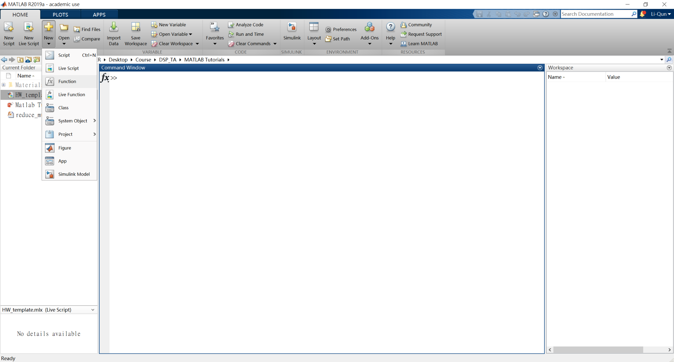


Open a New File
Script (*.m) :
純code文本文件格式
（一般紀錄MATLAB code常用的檔案）
Live Script (*.mlx) :
可穿插文字敘述與code內容，並實時執行結果
（EE3660 Homework used.）
Function (*.m) :
跟script一樣，但附上function的template （function的名稱需跟檔名一樣）
（ EE3660 Functions in HW used.）
其他file這堂課不太會用到

Slide 7
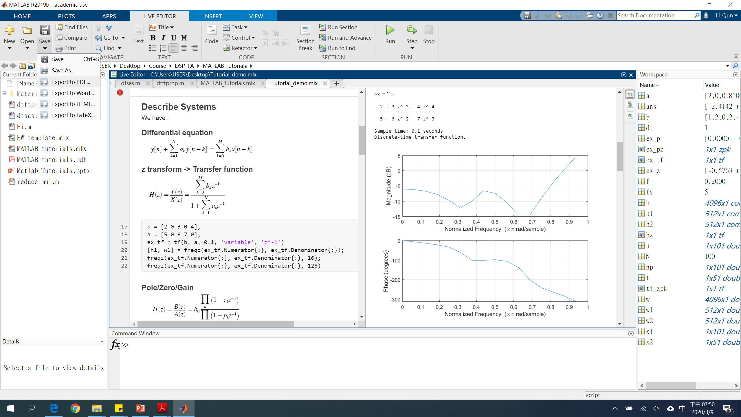
Live Script (*.mlx)
Programming Homework請用live script繳交，並在這裡附上你執行的方式、推導證明過程、結果的圖片、你的分析報告等等…
左側包含text, code, function..
右側即時顯示結果
Insert function
可輸出成
pdf, word, html, LaTeX

Slide 8
Basic MATLAB Function and Operation

Slide 9
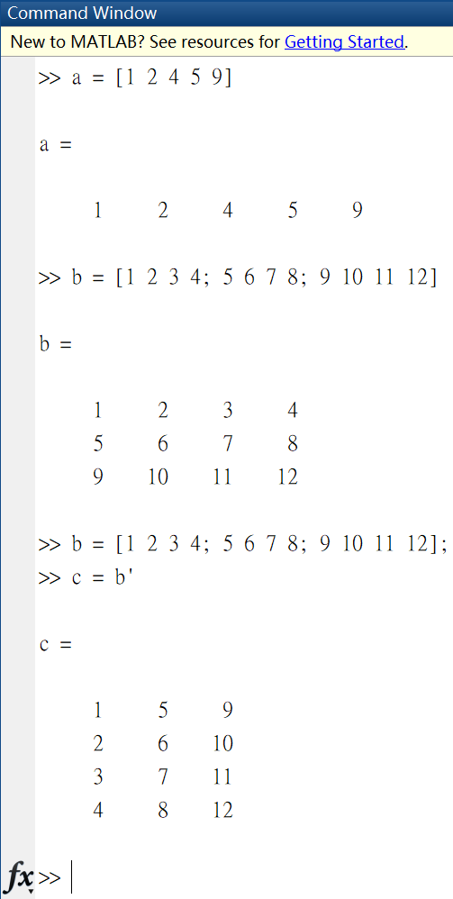
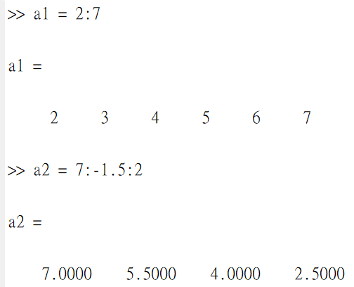
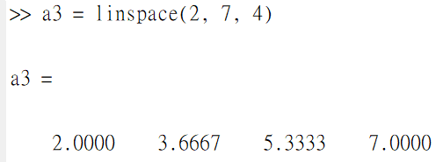
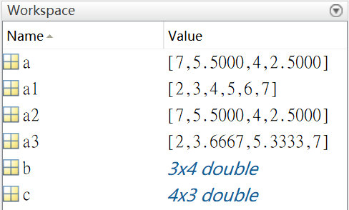
Construct an Array
Method1: Direct Assign
Method2: Set Start/End Value
Method3: Use Function
Other functions: zeros, ones, rand, etc.,
You can check these variables in Workspace or print in Command Window without “ ; ” ending

Slide 10
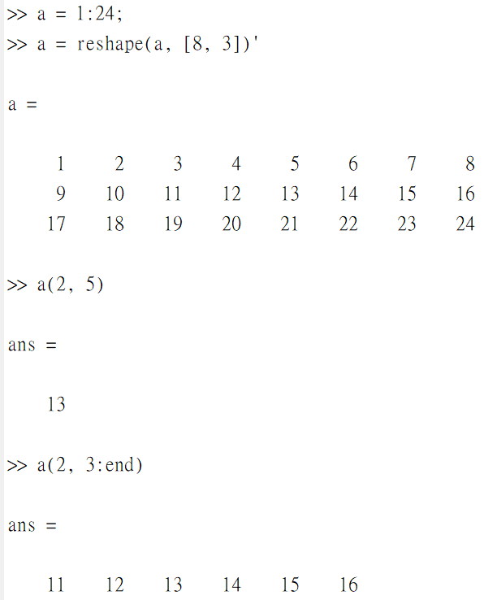
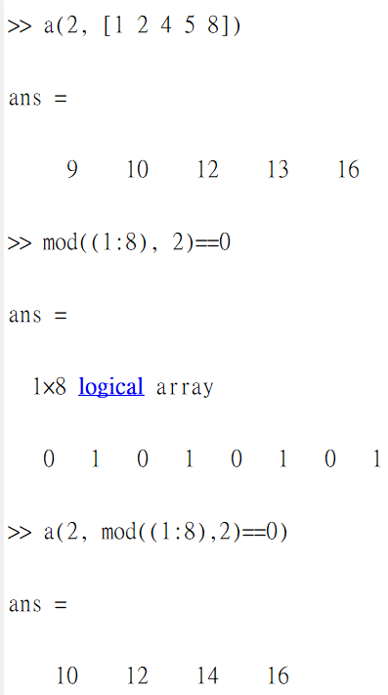
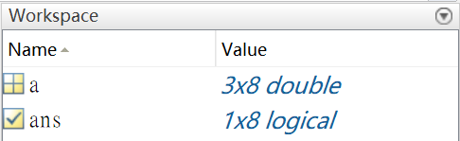
Array Indexing
Logical(Bool) Indexing

Slide 11
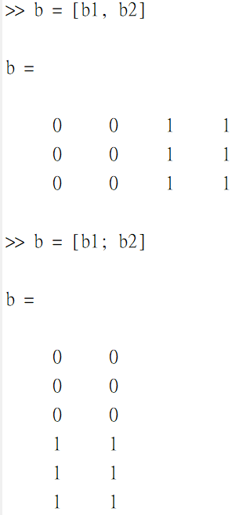
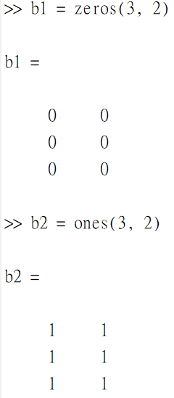
Array Concatenation

Slide 12
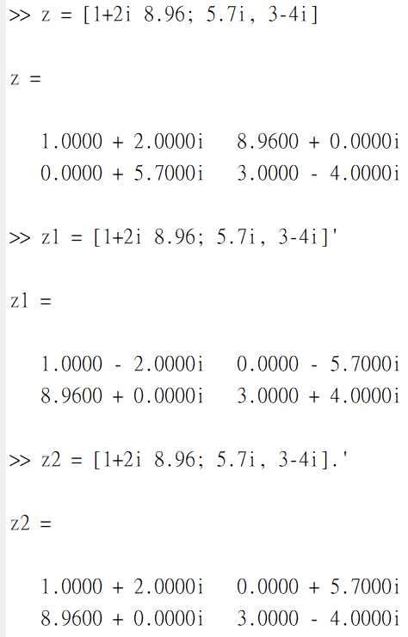
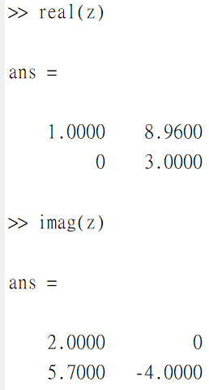
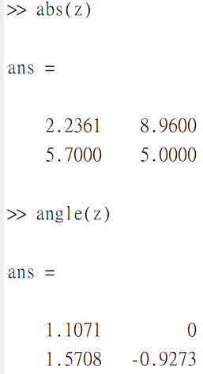
Complex Number (a + bi)
(unit: radian)

Slide 13
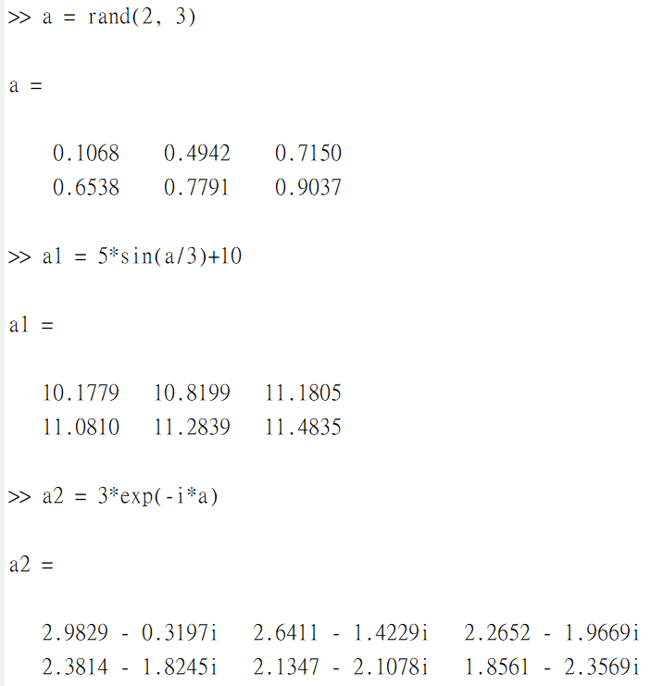
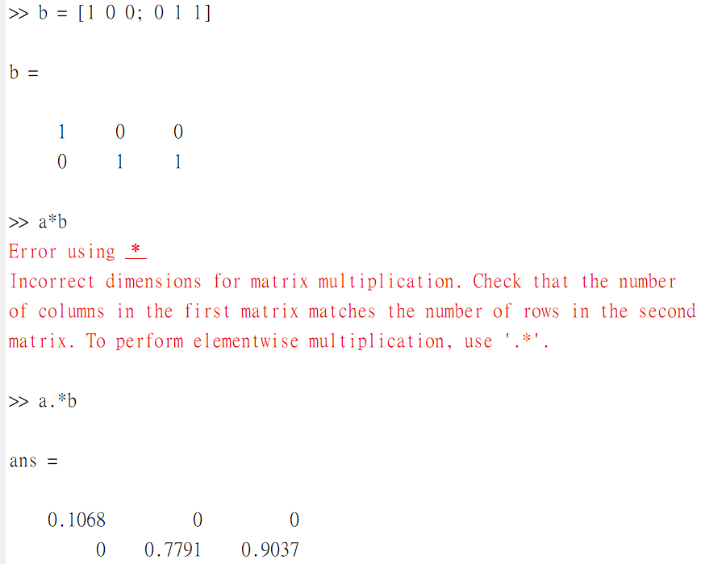
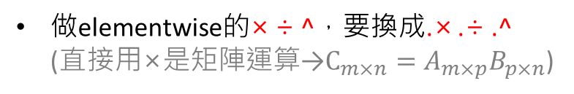
Operation (+ - × ÷ ^)
Scalar / Function Operation
Matrix Elementwise Operation
Error!
Correct!
做elementwise的× ÷ ^，要換成.× .÷ .^ (直接用×是矩陣運算→$C_{m×n}=A_{m×p}B_{p×n}$)

Slide 14
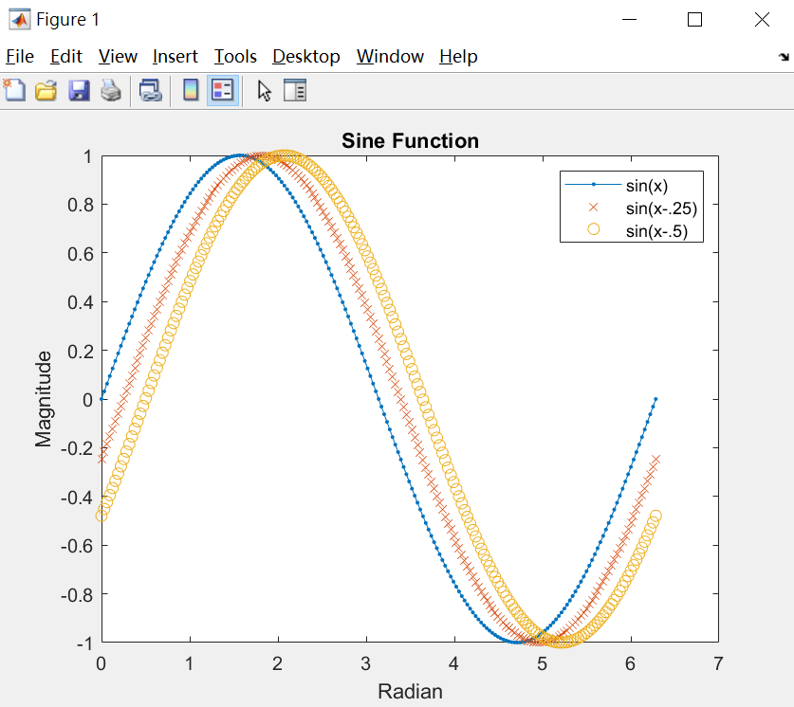
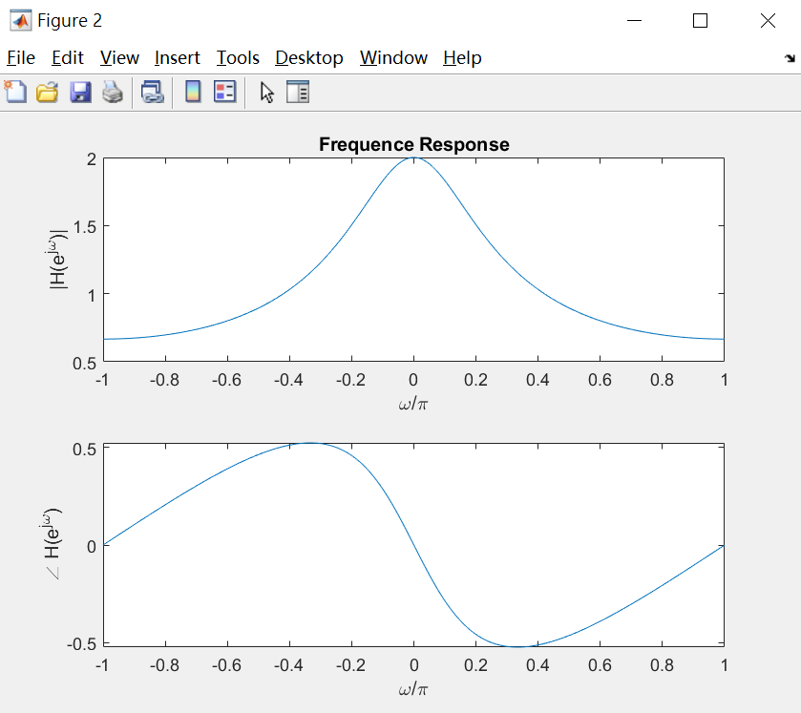
Plot Figures
w = linspace(-pi, pi, 1024);
H = 1./(1-0.5*exp(-i*w));
figure(2);
subplot(2,1,1);
plot(w/pi, abs(H));
title('Frequence Response');
xlabel('\omega/\pi');
ylabel('|H(e^{j\omega})|');
subplot(2,1,2);
plot(w/pi, angle(H));
xlabel('\omega/\pi');
ylabel('\angle H(e^{j\omega})');
x = 0:pi/100:2*pi;
y = sin(x);
y2 = sin(x-.25);
y3 = sin(x-.5);
plot(x, y, '.-', x, y2, 'x', x, y3, 'o')
legend('sin(x)','sin(x-.25)','sin(x-.5)');
title('Sine Function');
xlabel('Radian');
ylabel('Magnitude');
More figure templates: https://ww2.mathworks.cn/help/matlab/learn_matlab/basic-plotting-functions.html

Slide 15
Signal Processing in MATLAB

Slide 16
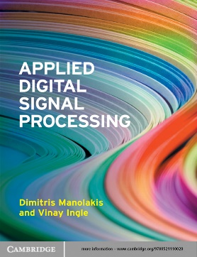
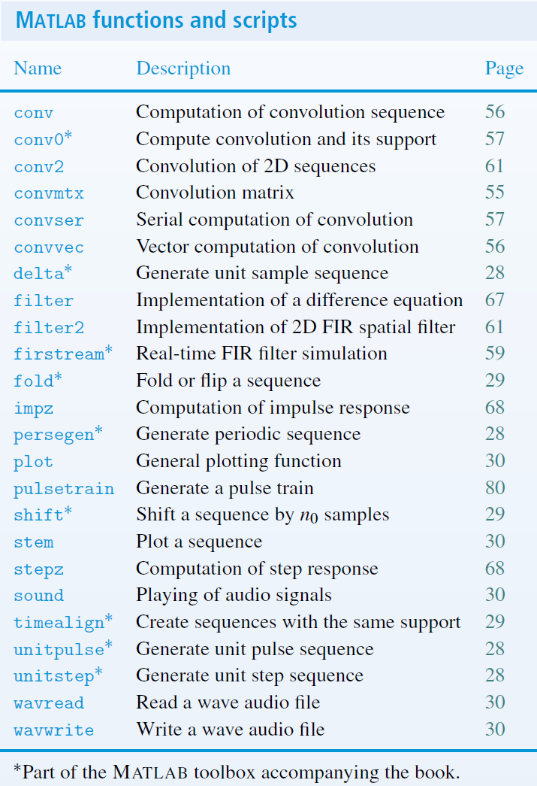
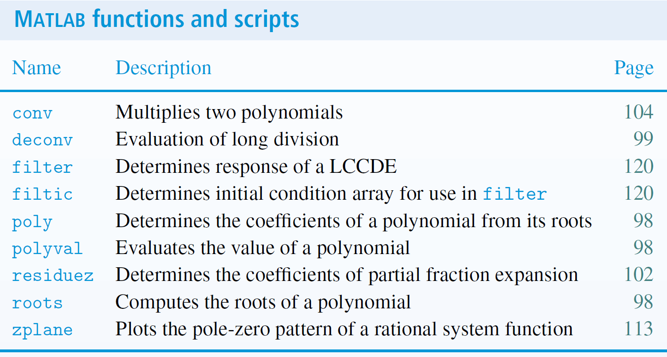
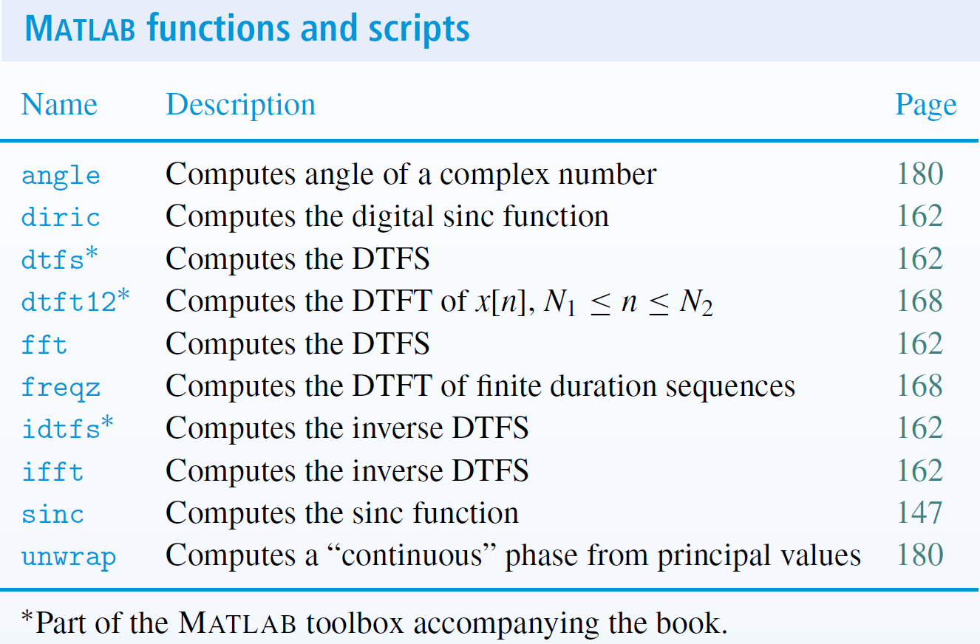
DSP Related Function
You can find DSP related functions in the textbook (at the end of each chapter)
Chapter 2
Chapter 3
Chapter 4

Slide 17
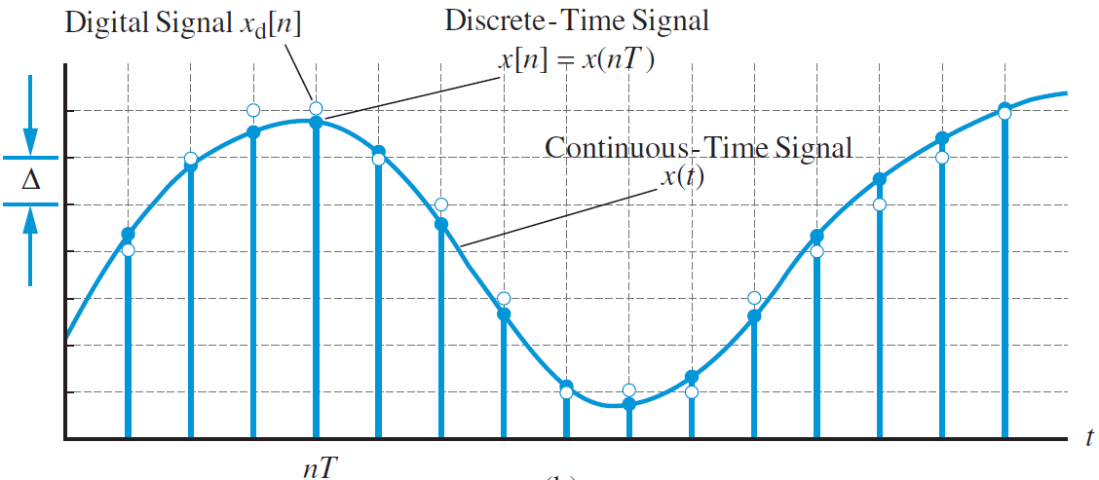
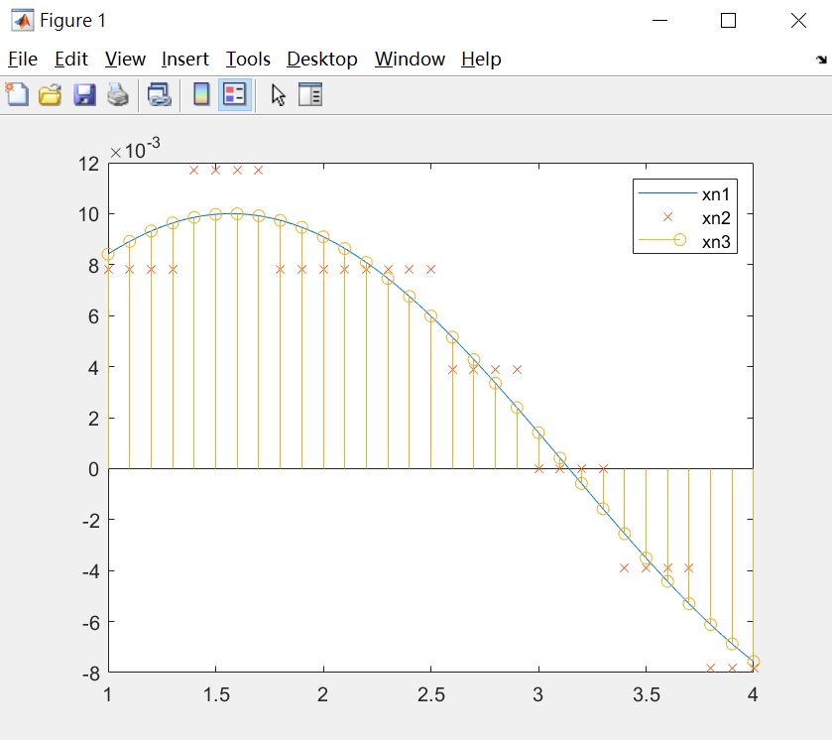

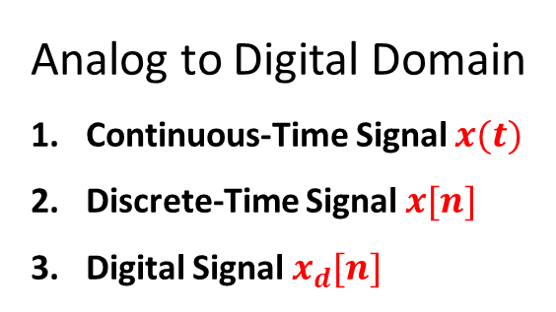
Signals
Analog to Digital Domain
Continuous-Time Signal $x(t)$
Discrete-Time Signal $x[n]$
Digital Signal $x_{d}[n]$
We generate signals in MATLAB:
n1 = linspace(1, 4, 1024);
xn1 = 0.01*sin(n1);
n2 = 1:0.1:4;
xn2 = 0.01*sin(n2);
n3 = 1:0.1:4;
xn3 = round(xn2*2^8)/2^8;
plot(n1, xn1, '-', n3, xn3, 'x');
hold on;
stem(n2, xn2);
legend('xn1', 'xn2', 'xn3');
Question: xn1 is $x\left(t\right)?$ $x\left[n\right]?$ or $x_{d}\left[n\right]?$ How about xn2 and xn3?
Answer: All signals stored by computer are $x_{d}[n]$

Slide 18
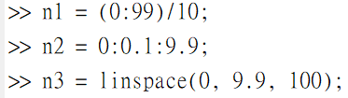
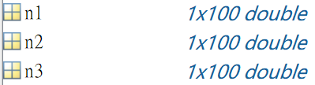

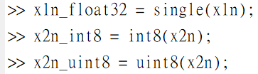


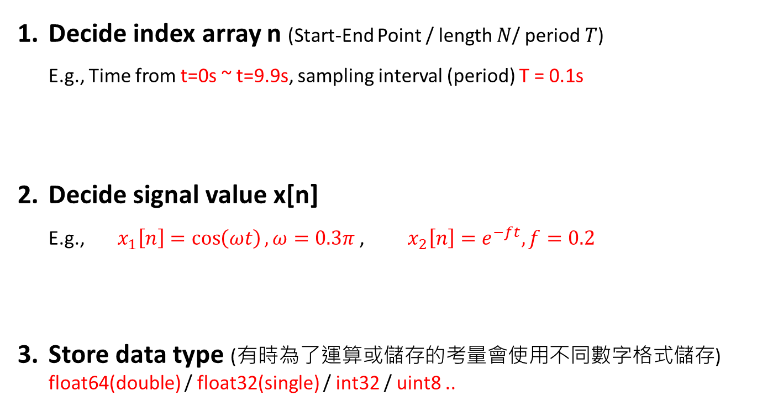
Describe Signal
Decide index array n (Start-End Point / length $N$/ period $T$) E.g., Time from t=0s ~ t=9.9s, sampling interval (period) T = 0.1s
Decide signal value x[n] E.g., $x_{1}\left[n\right]=\cos\left(ωt\right),ω=0.3π$ , $x_{2}\left[n\right]=e^{−ft},f=0.2$
Store data type (有時為了運算或儲存的考量會使用不同數字格式儲存) float64(double) / float32(single) / int32 / uint8 ..

Slide 19
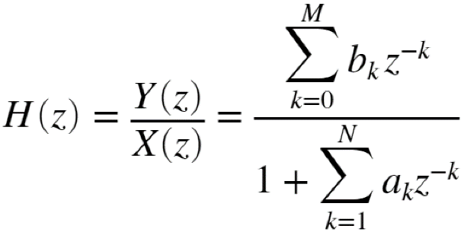
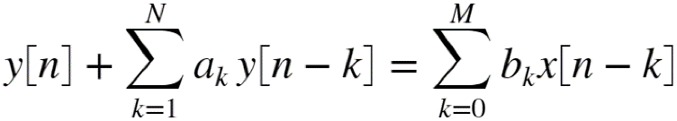
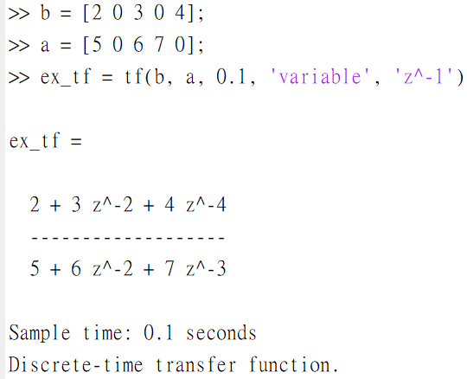
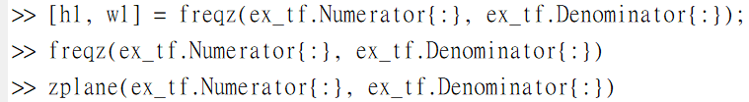
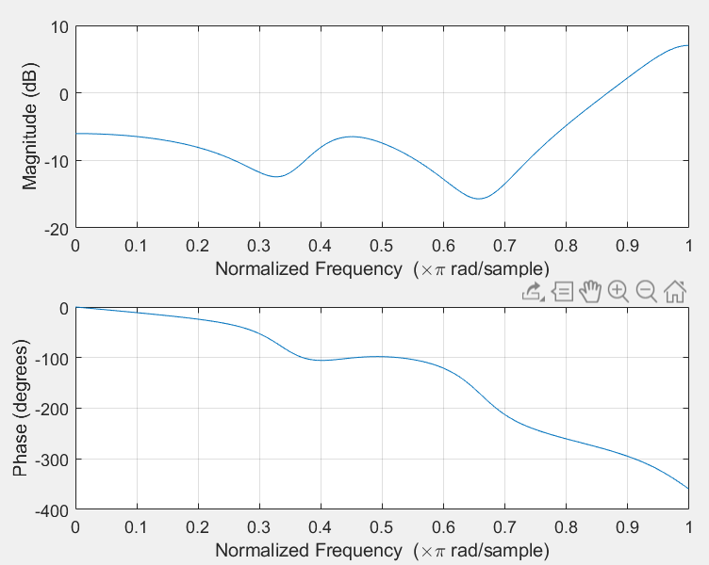
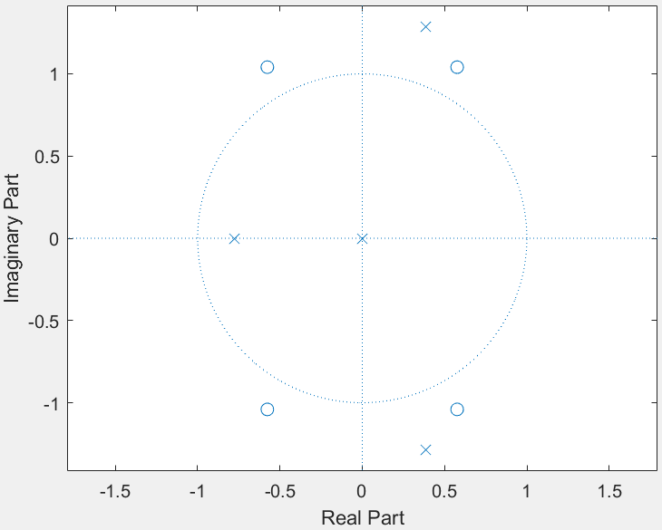
Describe System - 1
LTI Systems characterized by LCCDE:
Example:

Slide 20
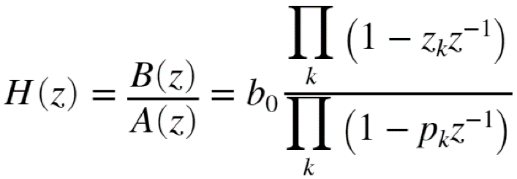
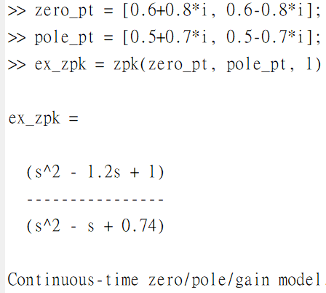
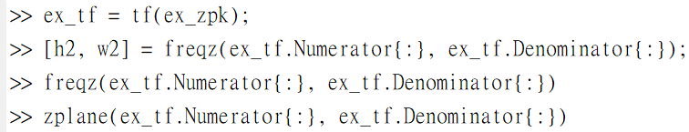
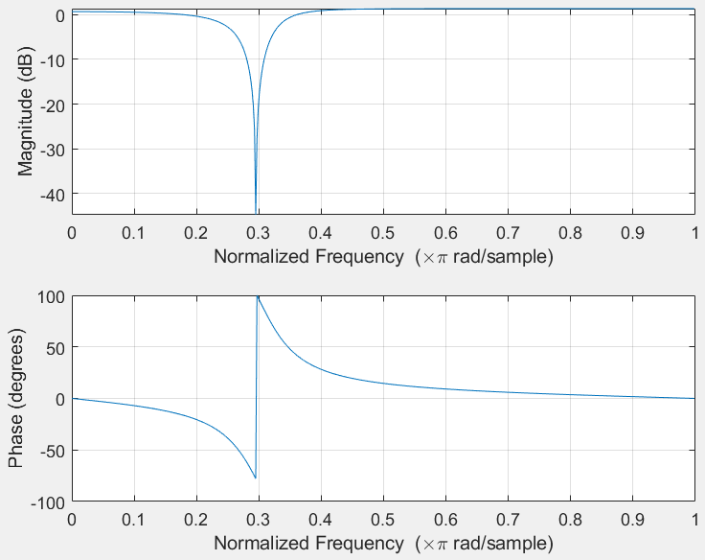
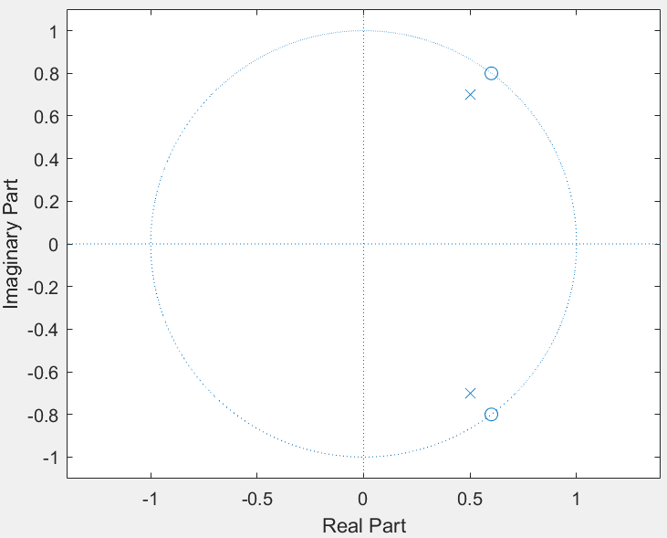
Describe System - 2
LTI Systems characterized by zero-pole plane:
Example:

Slide 21

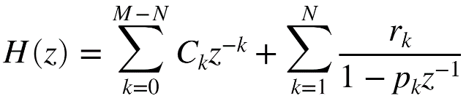
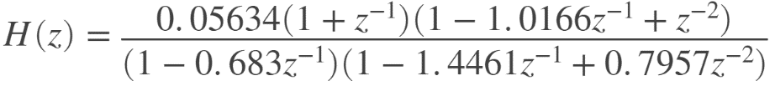
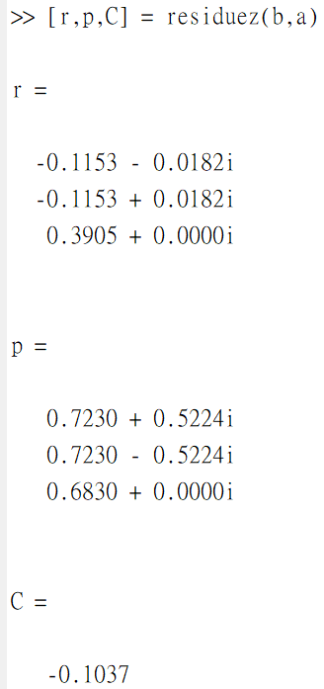
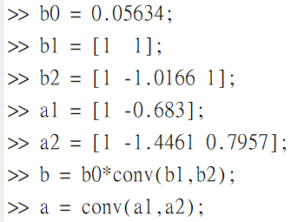
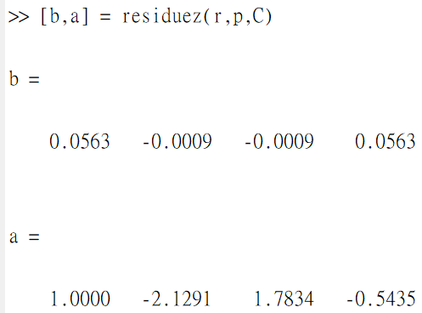
Partial-Fraction Expansion
You can use residuez to do the partial fraction expansion
Example:

Slide 22
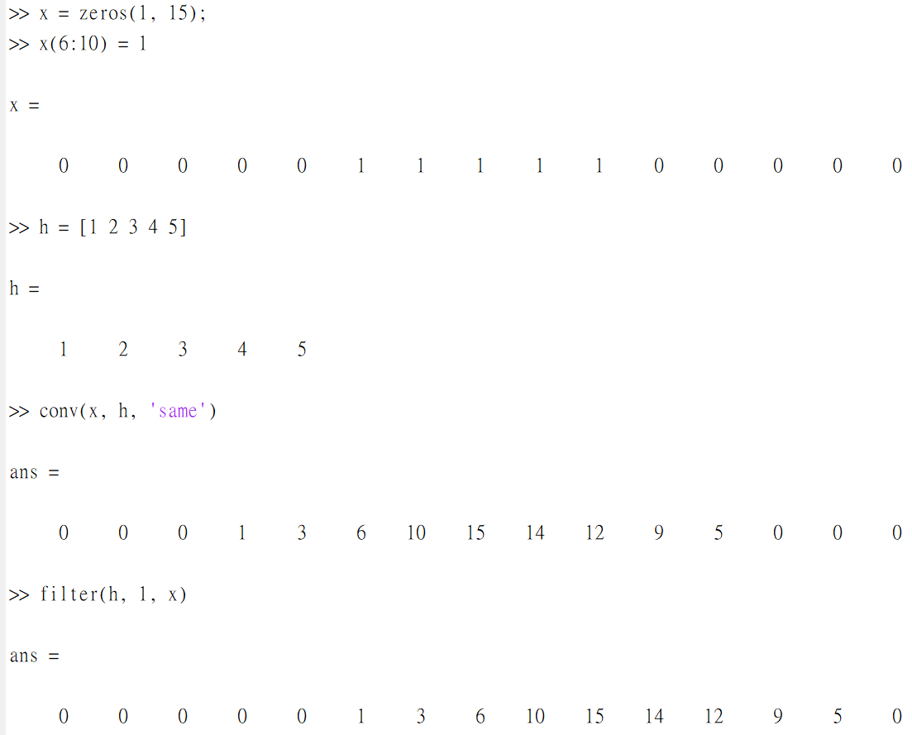
Convolution
You can use conv or filter to do the convolution
x[n]
h[n]
conv function
start
filter function
start

Slide 23

Other Useful Functions
You can type at comment window to search the usage document of the function freqz
Basic Function
linspace
abs/angle
real/Imag
round
zeros/ones
cos/exp/sinc
reshape
roots
randn
fold/shift*
mod/rem
length
resample
…
DSP Function
zpk/tf
freqz
zplane
residuez
conv
filter/filtic
impz/stepz
dtft12*
dtfs/idtfs*
fft/ifft
unwarp
phasez
lsim
…
Plot Function
figure
subplot
plot/stem
title
xlabel/ylabel
legend
xlim/ylim
hold
grid
…
App Function
imread
imshow
imwrite
conv2
filter2
audioread
audioplayer
play
audiowrite
…

Slide 24
Using MATLAB for Course and Homework

Slide 25
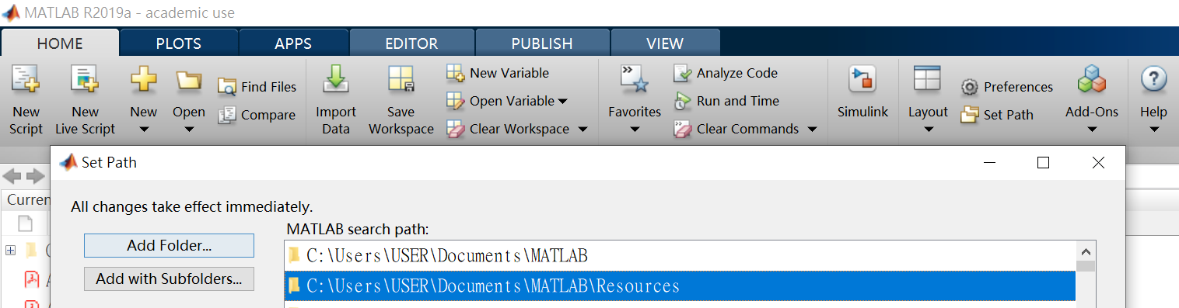
MATLAB Resources
Download from iLMS
Unzip the Resource folder to a safe location
Add the location to MATLAB path:
Home/Set Path
❶
❷
❸

Slide 26
Program Part of HW
參照MATLAB的建議，把每個function放到一個獨立的.m檔中
作業的分析討論用live script繳交，在這裡附上你執行的方式、推導證明過程、結果的圖片、你的分析報告…等，並存成HW{number}_{ID}.mlx
e.g. HW2_106010123.mlx

